Slide 1

ES1103: English for Academic Purposes Tutorial 5: Part B Noun Groups and Nominalisation
AHS/CELC/2024

Slide 2

Tutorial Learning Outcomes
By the end of the tutorial, you should be able to:
read complex and dense groups more easily by breaking down their parts
shift your grammar to an academic style using nominalisation
AHS/CELC/2024

Slide 3

Noun Groups
Using Noun Groups
Complex noun groups enable a writer to condense meaning to discuss abstract concepts in a precise and economical way.
Complex noun groups are also a means to sounding more impersonal, taking away the person who ‘does’ the action or presenting a debatable interpretation as an accepted fact.
AHS/CELC/2024

Slide 4
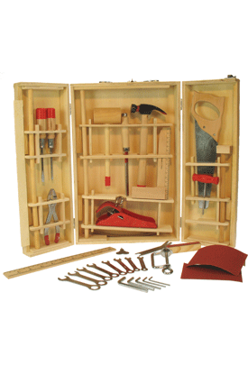
Noun Groups: Toolkit 3
Noun Groups
Purpose | To discuss abstract concepts
Features | Noun groups use of head nouns (Continued exposure to such chemicals can lead to reduced functioning of the auto-immune system.) Modifiers Prepositional phrase (of the auto-immune system, in the lab, at the top) Adjective (difficult, complicated) Relative clauses (who, which, whose, that) Nominalisation Verb→noun (to formulate→formulation) Adjective→noun (complex→complexity)
This is the toolkit to express the content of your discipline, including the technical words.
AHS/CELC/2024

Slide 5
Noun Groups
A noun group can become increasingly complex when we add information.
this book
this interesting book
this interesting children’s book
The words that appear before ‘book’ are pre-modifiers.
These words tell us something about the ‘book’.
In the examples above, ‘book’ is the head noun.
AHS/CELC/2024

Slide 6
Noun Groups: Pre-modifiers
There is a range of pre-modifiers that can be used in noun groups.
The number of pre-modifiers depends on how much information the writer wants to give about the head noun.
Pre-modifiers |  |  |  |  |  | Head noun
Determiner | Numeral | Adverb | Adjective | Participle Adjective (-ed, -ing) | Noun | Head noun
a |  |  |  |  |  | book
this |  |  | new |  |  | book
the |  |  | best |  | children’s | book
this | first | easily | readable | exciting | children’s | book
AHS/CELC/2024

Slide 7
Noun Groups: Post-modifiers
Post-modifiers are used after the head noun to provide further information.
The type of post-modifier depends on what kind of information the writer wants to give about the head noun.
Pre-modifiers |  |  |  | Head noun | Post-modifiers
Determiner | Adverb | Adjective | Noun | Head noun
a |  |  |  | book | is a great gift
this |  | small |  | book | was given to me
the |  | best | children’s | book | published this year
this | easily | readable | children’s | book | costs $20
this | easily | readable | children’s | book | which won a prize
AHS/CELC/2024

Slide 8
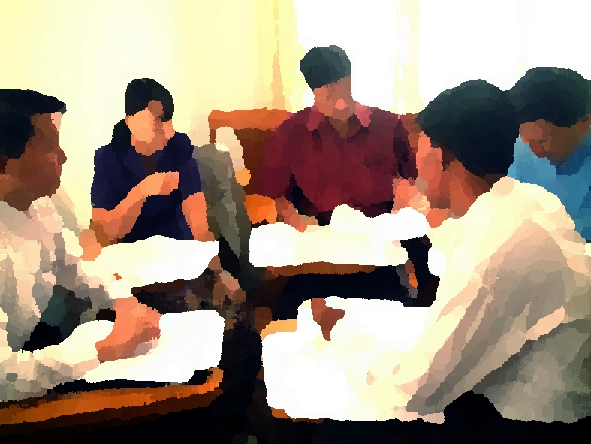
Identifying pre- and post-modifiers
Task 1
Read the paragraphs on pages 6 and 7 of the Tutorial 5 (Part B) notes ‘Noun Groups and Nominalisation’. Some noun groups are underlined in the paragraphs. What pre- and post-modifiers can you see in these noun groups? (Note that not all the noun groups are underlined.)
AHS/CELC/2024

Slide 9

Identifying pre- and post-modifiers
A major change which has occurred in the Western family is an increased incidence in divorce. Whereas in the past, divorce was a relatively rare occurrence, in recent times it has become quite commonplace. This change is borne out clearly in census figures. For example, thirty years ago in Australia, only one marriage in ten ended in divorce; nowadays, the figure is more than one in three (Australian Bureau of Statistics, 1996: p.45). A consequence of this change has been a substantial increase in the number of single parent families and the attendant problems that this brings (Kilmartin, 1997). An important issue for sociologists, and indeed for all of society, is why these changes in marital patterns have occurred. In this essay I will seek to critically examine a number of sociological explanations for the 'divorce phenomenon' and also consider the social policy implications that each explanation carries with it. It will be argued that the best explanations are to be found within a broad socio-economic framework.
Head noun
AHS/CELC/2024

Slide 10
Identifying pre- and post-modifiers
One type of explanation for rising divorce has focused on changes in laws relating to marriage. For example, Bilton, Bonnett and Jones (1987) argue that increased rates of divorce do not necessarily indicate that families are now more unstable. It is possible, they claim, that there has always been a degree of marital instability. They suggest that changes in the law have been significant, because they have provided unhappily married couples with 'access to a legal solution to pre-existent marital problems' (p.301). Bilton et al. therefore believe that changes in divorce rates can be best explained in terms of changes in the legal system. The problem with this type of explanation however, is that it does not consider why these laws have changed in the first place. It could be argued that reforms to family law, as well as the increased rate of divorce that has accompanied them, are the product of more fundamental changes in society.
Head noun
AHS/CELC/2024

Slide 11

Noun Groups: Subject-verb agreement
The verb usually agrees with the head noun.
Always identify the head noun to ensure you are writing the correct verb form.
The earnings differential between a high school graduate and a university degree holder is such that the initial financial burden that university fees constitute is well worthwhile.
The earnings differential between a high school graduate and a university degree holder is such that the initial financial burden that university fees constitute is well worthwhile.
Head noun | Verb
differential | is
burden | is
AHS/CELC/2024

Slide 12
Noun Groups: Subject-verb agreement
Task 2
Read the again paragraphs on divorce on pages 8 and 9 of the Tutorial 5 (Part B) notes ‘Noun Groups and Nominalisation’. Check the noun groups underlined in the paragraphs and identify the main verb. Is the main verb in each case plural or singular? Consider why this might be the case.
AHS/CELC/2024

Slide 13
Noun Groups: Subject-verb agreement
A major change which has occurred in the Western family is an increased incidence in divorce. Whereas in the past, divorce was a relatively rare occurrence, in recent times it has become quite commonplace. This change is borne out clearly in census figures. For example, thirty years ago in Australia, only one marriage in ten ended in divorce; nowadays, the figure is more than one in three (Australian Bureau of Statistics, 1996: p.45). A consequence of this change has been a substantial increase in the number of single parent families and the attendant problems that this brings (Kilmartin, 1997). An important issue for sociologists, and indeed for all of society, is why these changes in marital patterns have occurred. In this essay I will seek to critically examine a number of sociological explanations for the 'divorce phenomenon' and also consider the social policy implications that each explanation carries with it. It will be argued that the best explanations are to be found within a broad socio-economic framework.
Head noun
verb
AHS/CELC/2024

Slide 14
Noun Groups: Subject-verb agreement
One type of explanation for rising divorce has focused on changes in laws relating to marriage. For example, Bilton, Bonnett and Jones (1987) argue that increased rates of divorce do not necessarily indicate that families are now more unstable. It is possible, they claim, that there has always been a degree of marital instability. They suggest that changes in the law have been significant, because they have provided unhappily married couples with 'access to a legal solution to pre-existent marital problems' (p.301). Bilton et al. therefore believe that changes in divorce rates can be best explained in terms of changes in the legal system. The problem with this type of explanation however, is that it does not consider why these laws have changed in the first place. It could be argued that reforms to family law, as well as the increased rate of divorce that has accompanied them, are the product of more fundamental changes in society
Head noun
verb
AHS/CELC/2024

Slide 15


Noun Groups: Subject-verb agreement
Do not rely on grammar checking software to spot subject-verb agreement errors in long noun groups.
Most software refers back to the noun closest to the verb, which might not be the head noun in the noun group.
Always check your writing for the appropriate subject-verb agreement.
AHS/CELC/2024

Slide 16

Nominalisation
Nominalisation occurs when an action is expressed as a noun.
Example
is implied implication is
get better improvement in
referred to reference made
Nominalisation is a common feature in academic writing.
It allows the writer to discuss abstract concepts rather than staying at the level of who does what.
AHS/CELC/2024

Slide 17
Nominalisation
Compare the informal forms with the formal noun groups.
AHS/CELC/2024

Slide 18
Nominalisation
Nominalisation can be done by
removing reference to people
focusing on the concept or the phenomenon by making it into a noun and using it as a THEME
developing the concept further in the NEW
using verbs to carry the logical relation between the THEME and the NEW
AHS/CELC/2024

Slide 19
Nominalisation
Task 3
Look at the sentences in the table on page 12 of the Tutorial 5 (Part B) notes ‘Noun Groups and Nominalisation’. Use nominalisation to convert the informal English to formal academic English. You do not need to write a complete sentence.
AHS/CELC/2024

Slide 20
Nominalisation
 | Informal English (idea as expressed as clause) | Academic English (idea expressed in noun group)
1 | Because of this change, there are a lot more families that have only one parent.
2 | People want to have more things
3 | If we make it harder for people to get a divorce
4 | People are less and less willing to give money to this type of social welfare program
5 | A time when families are more and more unstable
AHS/CELC/2024

Slide 21
Nominalisation
 | Informal English (idea as expressed as clause) | Academic English (idea expressed as noun group)
1 | Because of this change, there are a lot more families that have only one parent. | The result of this change is an increase in single-parent families.
2 | People want to have more things | an increase in materialism
3 | If we make it harder for people to get a divorce | an increase in the difficulty to obtain a divorce will cause…
4 | People are less and less willing to give money to this type of social welfare program | a decrease in willingness to make donations to…
5 | A time when families are more and more unstable | a decrease in family stability
possible nominalisation
AHS/CELC/2024

Slide 22
Nominalisation
Task 4
Look at the task on page 13 of the Tutorial 5 (Part B) notes ‘Noun Groups and Nominalisation’. Practise converting the sentences from a less formal style to a more academic style using nominalisation. Select the most appropriate words in the box to help with your nominalisation.
AHS/CELC/2024

Slide 23
Nominalisation
Example
Less formal style:
If we keep cutting down trees in the Amazon region, we will have less oxygen everywhere.
Academic style:
Continued deforestation of the Amazon region will lead to worldwide oxygen depletion.
AHS/CELC/2024

Slide 24
Nominalisation
Less formal style
How much weight you lose depends on how often you exercise.
Being tolerant of the ways people are different is something that they often try to teach in courses about civics.
People get cancer more if there’s a lot of mercury in the water.
One of the ways a company can produce more is by encouraging employees to work together.
AHS/CELC/2024

Slide 25
Nominalisation
Task 5
Look at the task on pages 14-15 of the Tutorial 5 (Part B) notes ‘Noun Groups and Nominalisation’. Re-write the sentences by using the noun form of the underlined verbs and adjectives. You may need to change word order, forms of other words in the phrase, add articles, add prepositions.
AHS/CELC/2024

Slide 26
Nominalisation
Example: The students’ performance has improved → university’s ranking has increased Improvement in student performance has led to an increase in the university’s ranking.
AHS/CELC/2024

Slide 27
Nominalisation
1. It is difficult to balance studies and part-time jobs → time management is important
____________________________ demonstrates _____________________________.
2. [People] succeed in examinations → they apply appropriate strategies
_________________________ is dependent on ______________________________.
3. Information technology has developed rapidly → older generation is occasionally confused
______________________________ causes __________________________________.
AHS/CELC/2024

Slide 28
Nominalisation
4. Problems in the workplace are solved → [People are] creative
_____________________________ require[s] _________________________________.
5. [People are] able to speak several languages → better careers are possible
_______________________________ can lead to ______________________________.
6. The two countries agreed → they reduced their supplies of nuclear arms.
_______________ between _____________ resulted in a ________________________.
AHS/CELC/2024

Slide 29

Noun Groups and Nominalisation
Developing sentences with noun groups and nominalisation is important for presenting abstract ideas clearly and logically in academic writing.
Familiarising yourself with these techniques will be of benefit in your writing at university.
AHS/CELC/2024

Slide 30
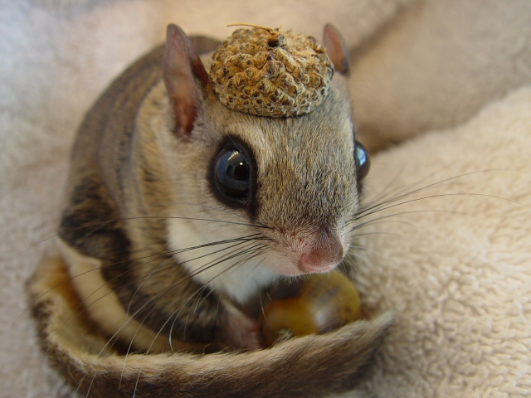
Summary
In this tutorial, we have considered how to:
read complex and dense groups more easily by breaking down their parts
shift your grammar to an academic style using nominalisation
AHS/CELC/2024

Slide 31

Acknowledgements
All still images in these slides are used under the Creative Commons License.
AHS/CELC/2024

